Slide 1


East west college of engineering
Virtual Mouse using Hand Gesture Recognition
Project Members
Guided By
ANUSHA.R.D (1EE22CS400) PROF.CHAITRA K R
D SIMRAN (1EE22CS401)
NANDINI K C (1EE22CS404)
RAJASHEKAR (1EE22CS403)

Slide 2
contents
Introduction
Problem statement
Proposed system
Literature survey
System requirements
Methodology Design
Expected output

Slide 3
Introduction
This project is to develop a Virtual Mouse using Hand Gesture Recognition.
The hand gestures are the most effortless and natural way of communication.
The aim is to perform various operations of the cursor.
Instead of using more expensive sensors, a simple web camera can identify the gesture and perform the action.
It helps the user to interact with a computer without any physical and hardware device to control mouse operation.

Slide 4
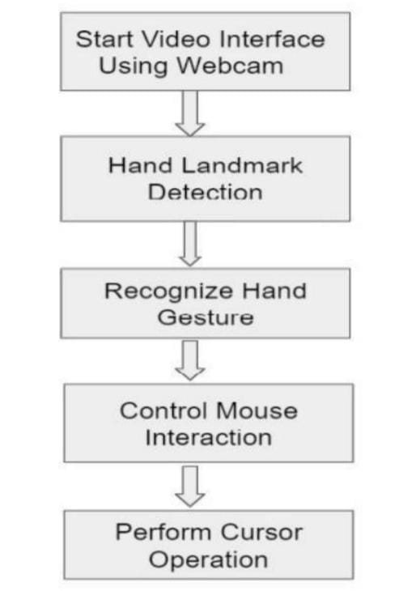
Proposed System

Slide 5
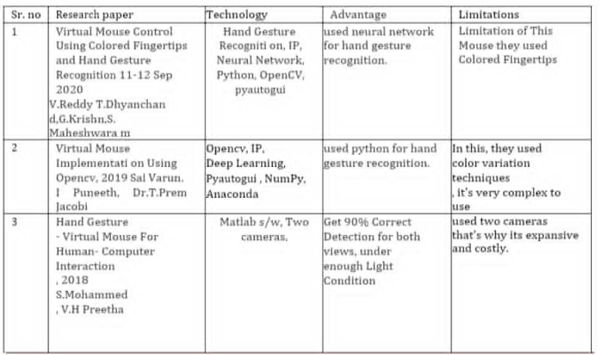
Literature survey

Slide 6
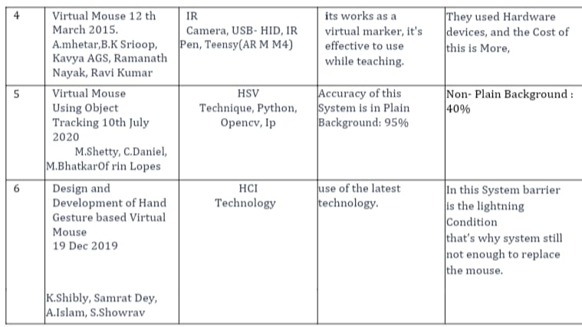

Slide 7
Software Requirement
Visual studio code
Used Language/library:
Python
OpenCv
Media Pipe
Pyautogui
pycaw
Scrven-brightness-control
Hardware Requirement
1. Windows 10
webcam
Minimum RAM 2GB
Intel core i5 processor

Slide 8
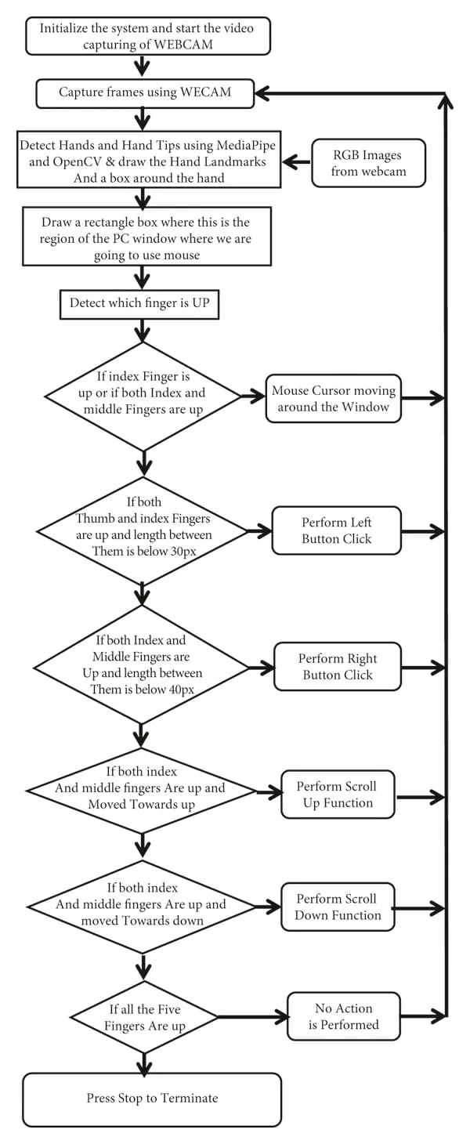
Methodology

Slide 9
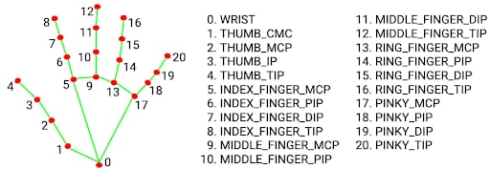

Slide 10
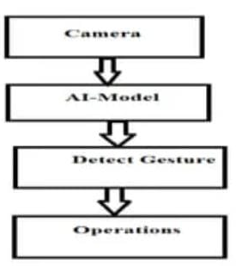
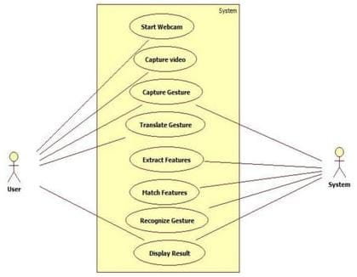
Design
Usecase Diagram
Block Diagram

Slide 11
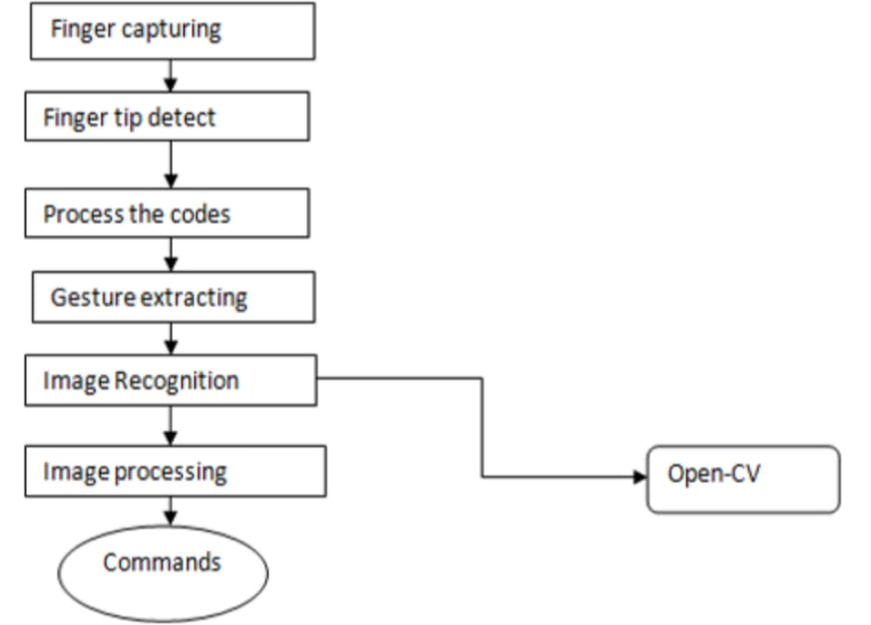
Data flow Diagram

Slide 12
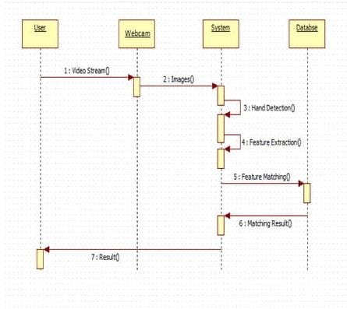
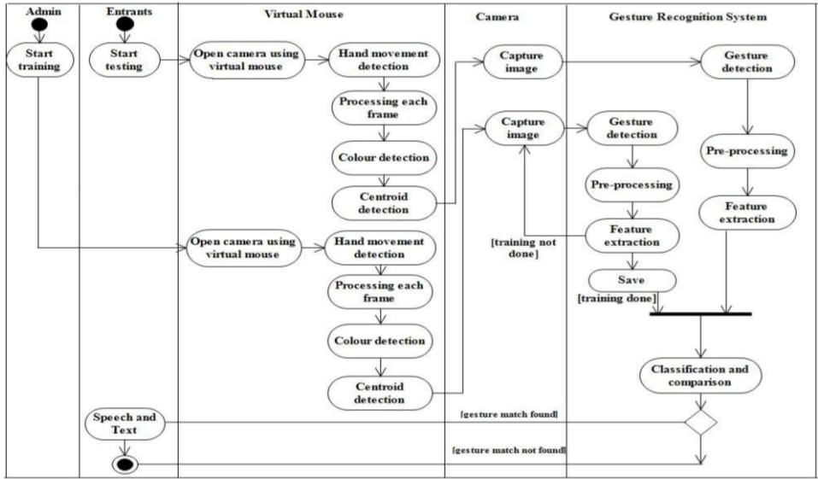
Sequence Diagram
Activity Diagram

Slide 13
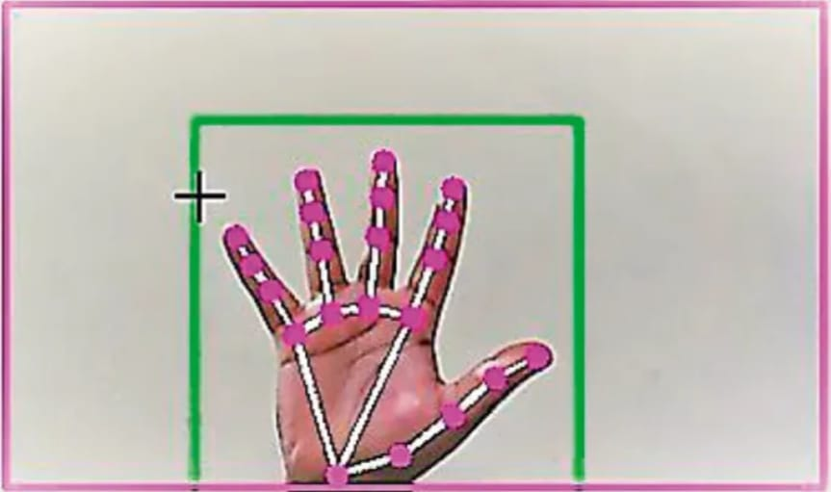
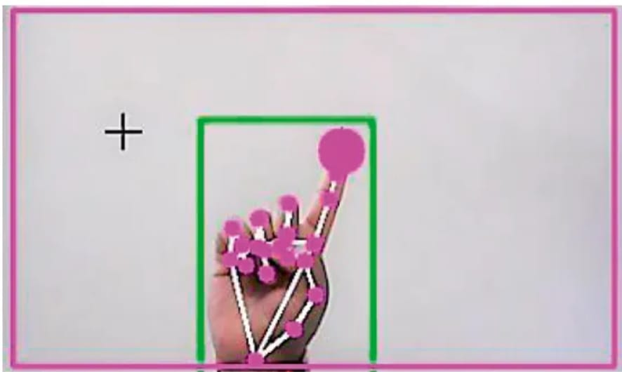
Expect output

Slide 14
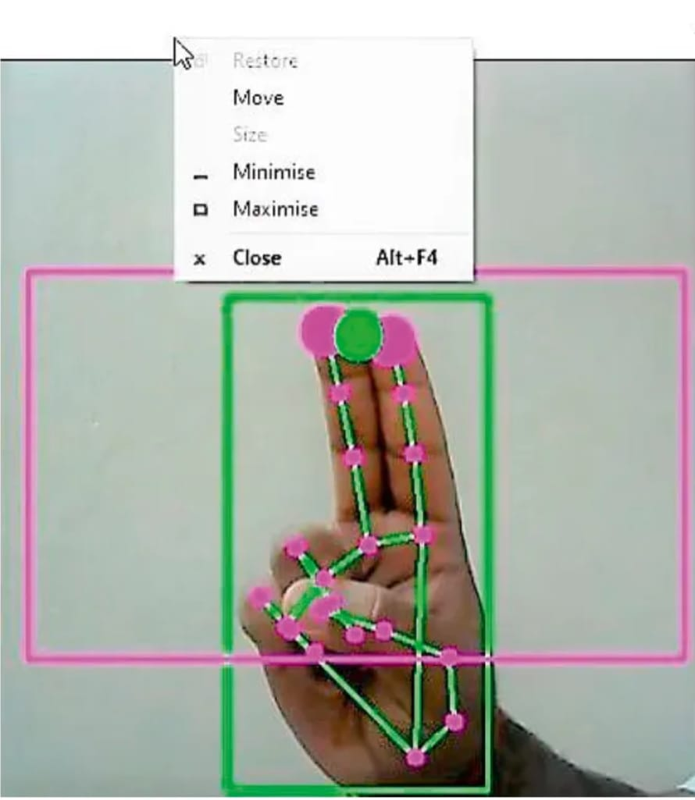
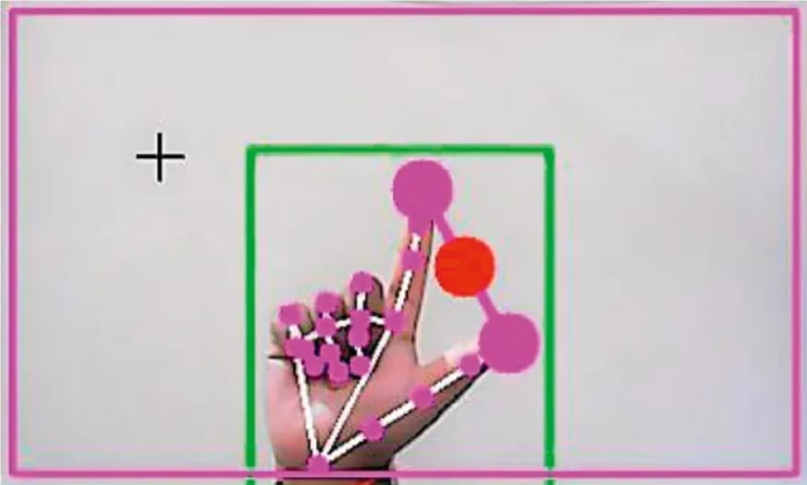

Slide 15
Thank you

